Slide 1
Session -3
A Generic Process Model

Slide 2
a process was defined as a collection of work activities, actions, and tasks that are performed when some work product is to be created
each framework activity is populated by a set of software engineering actions.
Each software engineering action is defined by a task set that
identifies the work tasks that are to be completed,
the work products that will be produced,
the quality assurance points that will be required,
and the milestones that will be used to indicate progress.

Slide 3
A Generic Process Model
Software process
Process framework
Umbrella activities
framework activity #1
framework activity #2
SE action #1.1
SE action #2.1
task sets | ⎧ ⎨ ⎩ | work tasks work products QA points milestones
task sets | ⎧ ⎨ ⎩ | work tasks work products QA points milestones
SE action #1.2
SE action #2.2
task sets | ⎧ ⎨ ⎩ | work tasks work products QA points milestones
task sets | ⎧ ⎨ ⎩ | work tasks work products QA points milestones
Notes:
a process was defined as a collection of work activities, actions, and tasks that are performed when some work product is to be created

Slide 4
Process Flow: How the framework activities, actions, tasks occur within each framework activity
A linear process flow executes each of the five framework activities in sequence,
beginning with communication and culminating with deployment
An iterative process flow repeats one or more of the activities before proceeding to the next.
An evolutionary process flow executes the activities in a “circular” manner. Each circuit through the five activities leads to a more complete version of the software
A parallel process flow executes one or more activities in parallel with other activities (e.g., modeling for one aspect of the software might be executed in parallel with construction of another aspect of the software).

Slide 5
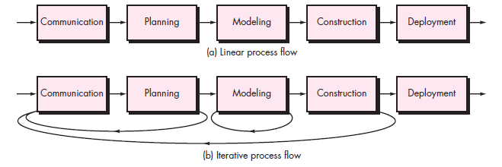

Slide 6
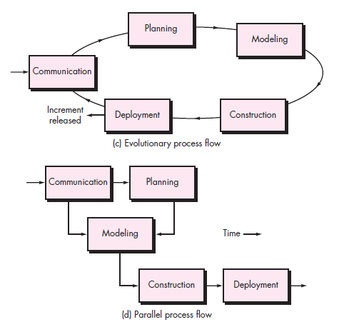

Slide 7
Prescriptive Process models

Slide 8
Prescriptive Process models
Waterfall Model.
Incremental Process Model.
Evolutionary Process Model.
Concurrent model
8

Slide 9
Prescriptive Process models
Waterfall Model
Oldest software lifecycle model & best understood by upper management
Used when requirements are well understood and risk is low
Work flow is in a linear fashion (i.e., sequential)
Used often with well-defined adaptations or enhancements to current software
9

Slide 10
Communication
Project initiation
Requirement gathering
Planning
Estimating
Scheduling
Tracking
Modeling
Analysis
Design
Construction
Code
Test
Deployment
Delivery
Support
Feedback

Slide 11
Waterfall Model
Useful
Where requirements are fixed and is to proceed to completion in a linear manner.
11

Slide 12
Cons in Water fall model
Real projects rarely follow the sequential flow that the model proposes
It is often difficult for the customer to state all requirements explicitly
The customer must have patience. A working version of the program(s) will not be available until late in the project time span

Slide 13
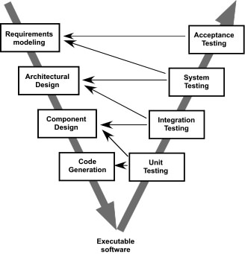
The V-Model

Slide 14
The V-model provides a way of visualizing how verification and validation actions are applied to earlier engineering work
V- model means Verification and Validation model. Just like the waterfall model, the V-Shaped life cycle is a sequential path of execution of processes. Each phase must be completed before the next phase begins

Slide 15
Advantages of V-model:
Simple and easy to use.
Testing activities like planning, test designing happens well before coding. This saves a lot of time. Hence higher chance of success over the waterfall model.
Defects are found at early stage.
Works well for small projects where requirements are easily understood.

Slide 16
Disadvantages of V-model:
Very rigid and least flexible.
Software is developed during the implementation phase, so no early prototypes of the software are produced.
If any changes happen in midway, then the test documents along with requirement documents has to be updated.

Slide 17
When to use the V-model:
The V-shaped model should be used for small to medium sized projects where requirements are clearly defined and fixed.
The V-Shaped model should be chosen when ample technical resources are available with needed technical expertise.

Slide 18
Prescriptive Process models
Incremental Process Model
Combines elements of linear and parallel process flows.
It delivers a series of releases, called increments that provide progressively more functionality for the customer as each is delivered
The first increment is often a core product.
The plan addresses the modification of the core product to better meet the needs of the customer and the delivery of additional feature and functionality.
It focuses on the delivery of an operational product with each increment.
18

Slide 19
Incremental Process Model
It is useful when staffing is unavailable for a complete implementation.
Increments can be planned to manage technical risks.
Communication
Software functionality and features
Planning
Modeling (analysis, design)
Construction (code, test)
Deployment ( delivery, feedback)
Delivery of n^{th} Increment
Delivery of 2nd Increment
Delivery of 1st Increment
Project calendar Time
19

Slide 20
For example, word-processing software developed using the incremental paradigm might deliver basic file management, editing, and document production functions in the first increment; more sophisticated editing and document production capabilities in the second increment; spelling and grammar checking in the third increment; and advanced page layout capability in the fourth increment

Slide 21
Advantages of Incremental model:
Generates working software quickly and early during the software life cycle.
This model is more flexible – less costly to change scope and requirements.
It is easier to test and debug during a smaller iteration.
In this model customer can respond to each built.
Lowers initial delivery cost.
Easier to manage risk because risky pieces are identified and handled during it’s iteration.

Slide 22
Disadvantages of Incremental model:
Needs good planning and design.
Needs a clear and complete definition of the whole system before it can be broken down and built incrementally.
Total cost is higher than waterfall.

Slide 23
When to use the Incremental model:
This model can be used when the requirements of the complete system are clearly defined and understood.
Major requirements must be defined; however, some details can evolve with time.
There is a need to get a product to the market early.
A new technology is being used

Slide 24
Evolutionary Process Model
Software, like Complex systems evolve over a period of time
-Business and product requirements often change as development proceeds.
- tight market deadlines make completion of a comprehensive software product impossible, but a limited version must be introduced to meet competitive or business pressure
- a set of core product or system requirements is well understood, but the details of product or system extensions have yet to be defined.
Evolutionary models are iterative.
Evolutionary Process Model produce an increasingly more complete version of the software with each iteration.
Specification, development and validation are interleaved.
24

Slide 25
Prescriptive Process models
Evolutionary Process Model
Prototyping
Spiral Model
25

Slide 26
Prototype Model is a software development life cycle model which is used when the customer is not known completely about how the end product should be and its requirements. So in this model, a prototype of the end product is first developed by the developers and then tested and changes were made as per customer feedback until the customer is satisfied with the prototype.

Slide 27
Evolutionary Process Model
1. Prototyping
It assists you and stakeholders to better understand what is to built when requirements are fuzzy.
Prototyping paradigm
-begins with communication.
- planned quickly and modelling occurs
- quick design focuses on a representation of those aspects of the software that will be visible to end users.
It serves as a mechanism for identifying software requirements.
a first or preliminary version of a device or vehicle from which other forms are developed
27

Slide 28
Prototyping Model(Diagram)
Quick Planning
Communication
Start
Modeling
Quick Design
Deployment,
Delivery,
and Feedback
Construction
Of Prototype
28

Slide 29
Advantages of Prototype model:
Users are actively involved in the development
Since in this methodology a working model of the system is provided, the users get a better understanding of the system being developed.
Errors can be detected much earlier.
Quicker user feedback is available leading to better solutions.
Missing functionality can be identified easily
Confusing or difficult functions can be identified

Slide 30
Disadvantages of Prototype model:
Leads to implementing and then repairing way of building systems.
Practically, this methodology may increase the complexity of the system as scope of the system may expand beyond original plans.
Incomplete application may cause application not to be used as the full system was designed
Incomplete or inadequate problem analysis.
When to use Prototype model:
Prototype model should be used when the desired system needs to have a lot of interaction with the end users.
Typically, online systems, web interfaces have a very high amount of interaction with end users, are best suited for Prototype model. It might take a while for a system to be built that allows ease of use and needs minimal training for the end user.

Slide 31
Evolutionary Process Model 2. Spiral development
Originally proposed by Barry Boehm.
It couples the iterative nature of prototyping with the controlled and systematic aspects of water fall model.
Process is represented as a spiral rather than as a sequence of activities with backtracking.
Each loop in the spiral represents a phase in the process.
No fixed phases such as specification or design - loops in the spiral are chosen depending on what is required.
Risks are explicitly assessed and resolved throughout the process.
31

Slide 32
The process of development is fast.
There is control towards all phases of development.
Customer feedback is taken into consideration and changes implemented as soon as possible.
Many and more features are added systematically.
Most ideal for large and risky projects.

Slide 33
Spiral model
It is a realistic approach to the development of large-scale systems and software.
The software evolves as the process progresses, the developer and customer better understand and react at each evolutionary level.
It uses prototyping as a risk reduction mechanism.
It demands considerable risk assessment expertise and realise on this expertise for success.
33

Slide 34
Spiral Model (Diagram)
Planning
Communication
Start
Modeling
Start
Deployment
Construction
34

Slide 35
Advantages of Spiral model:
High amount of risk analysis hence, avoidance of Risk is enhanced.
Good for large and mission-critical projects.
Strong approval and documentation control.
Additional Functionality can be added at a later date.
Software is produced early in the software life cycle.

Slide 36
Disadvantages of Spiral model:
Can be a costly model to use.
Risk analysis requires highly specific expertise.
Project’s success is highly dependent on the risk analysis phase.
Doesn’t work well for smaller projects.

Slide 37
When to use Spiral model:
When costs and risk evaluation is important
For medium to high-risk projects
Long-term project commitment unwise because of potential changes to economic priorities
Users are unsure of their needs
Requirements are complex

Slide 38
Evolutionary development
Problems
Do not establish the max. speed of the evolution.
Systems are often poorly structured;
Special skills (e.g. in languages for rapid prototyping) may be required.
Project management and estimation technique do not fit completely.
Applicability
For small or medium-size interactive systems;
For parts of large systems (e.g. the user interface);
For short-lifetime systems.
38

Slide 39
Concurrent Model
The concurrent development model sometimes called Concurrent Engineering.
It allows team to represent iterative and concurrent elements of any of the process models.
All software engineering activities exist concurrently but reside in different states.
Concurrent modeling defines a series of events that will trigger transitions from state to state for each of the activities.
Concurrent modeling is applicable to all types of software development and provide an accurate picture of the current state of a project.
39

Slide 40
Concurrent models are those models within which the various activities of software development happen at the same time, for faster development and a better outcome. The concurrent model is also referred to as a parallel working model
Advantages of the concurrent development model
This model is applicable to all types of software development processes.
It is easy for understanding and use.
It gives immediate feedback from testing.
It provides an accurate picture of the current state of a project.
Disadvantages of the concurrent development model
It needs better communication between the team members. This may not be achieved all the time.
It requires to remember the status of the different activities.

Slide 41
One element of the concurrent process model
Inactive
State of a s/w eng. activity
Modeling Activity
Under
Development
Awaiting
Changes
Under
Review
Under
Revision
Baselined
Done
End of Session - 3

Slide 42
Questions:
What Classic life cycle model.
Disadvantages of Incremental Process Model.
Main drawback of Prototyping Model.
Speciality in Spiral Model.
Need of Process models in Software development.
Advantages of Spiral model.
Disadvantages of Spiral model.
Advantages of Evolutionary model.
Disadvantages of Evolutionary model.
Specialty of Concurrent model.
Difference between Waterfall model and Spiral model.

